Slide 1
CORONA VIRUS ANALYSIS WITH SQL
Name: Shahid Ali
Batch: MIP-DA-07

Slide 2
Project Overviwe
The CORONA VIRUS pandemic has had a significant impact on public health and has created an urgent need for data-driven insights to understand the spread of the virus.
As a data analyst, you have been tasked with analyzing a CORONA VIRUS dataset to derive meaningful insights and present your findings.

Slide 3

Project Objective
The aim is to delve into the impact of the COVID-19 pandemic using SQL data analysis. We'll analyze crucial metrics like confirmed cases, fatalities, and recoveries to uncover trends, patterns, and correlations in the virus's spread.

Slide 4
Dataset Description
Description of each columns in dataset
01
02
03
04
Province
Country
Latitude
Longitude
Geographic subdivision within a country/region
Geographic entity where data is recorded
North-south position on Earth's surface
East-west position on Earth's surface
06
07
08
05
Date
Confirmed
Deaths
Recovered
Recorded date of CORONA VIRUS data
Number of diagnosed CORONA VIRUS cases
Number of CORONA Virus-related deaths
Number of recovered CORONA VIRUS cases

Slide 5
DATABASE SETUP AND UESD TOOLS
Let's dive in analyzing the corona virus with SQL.

Slide 6
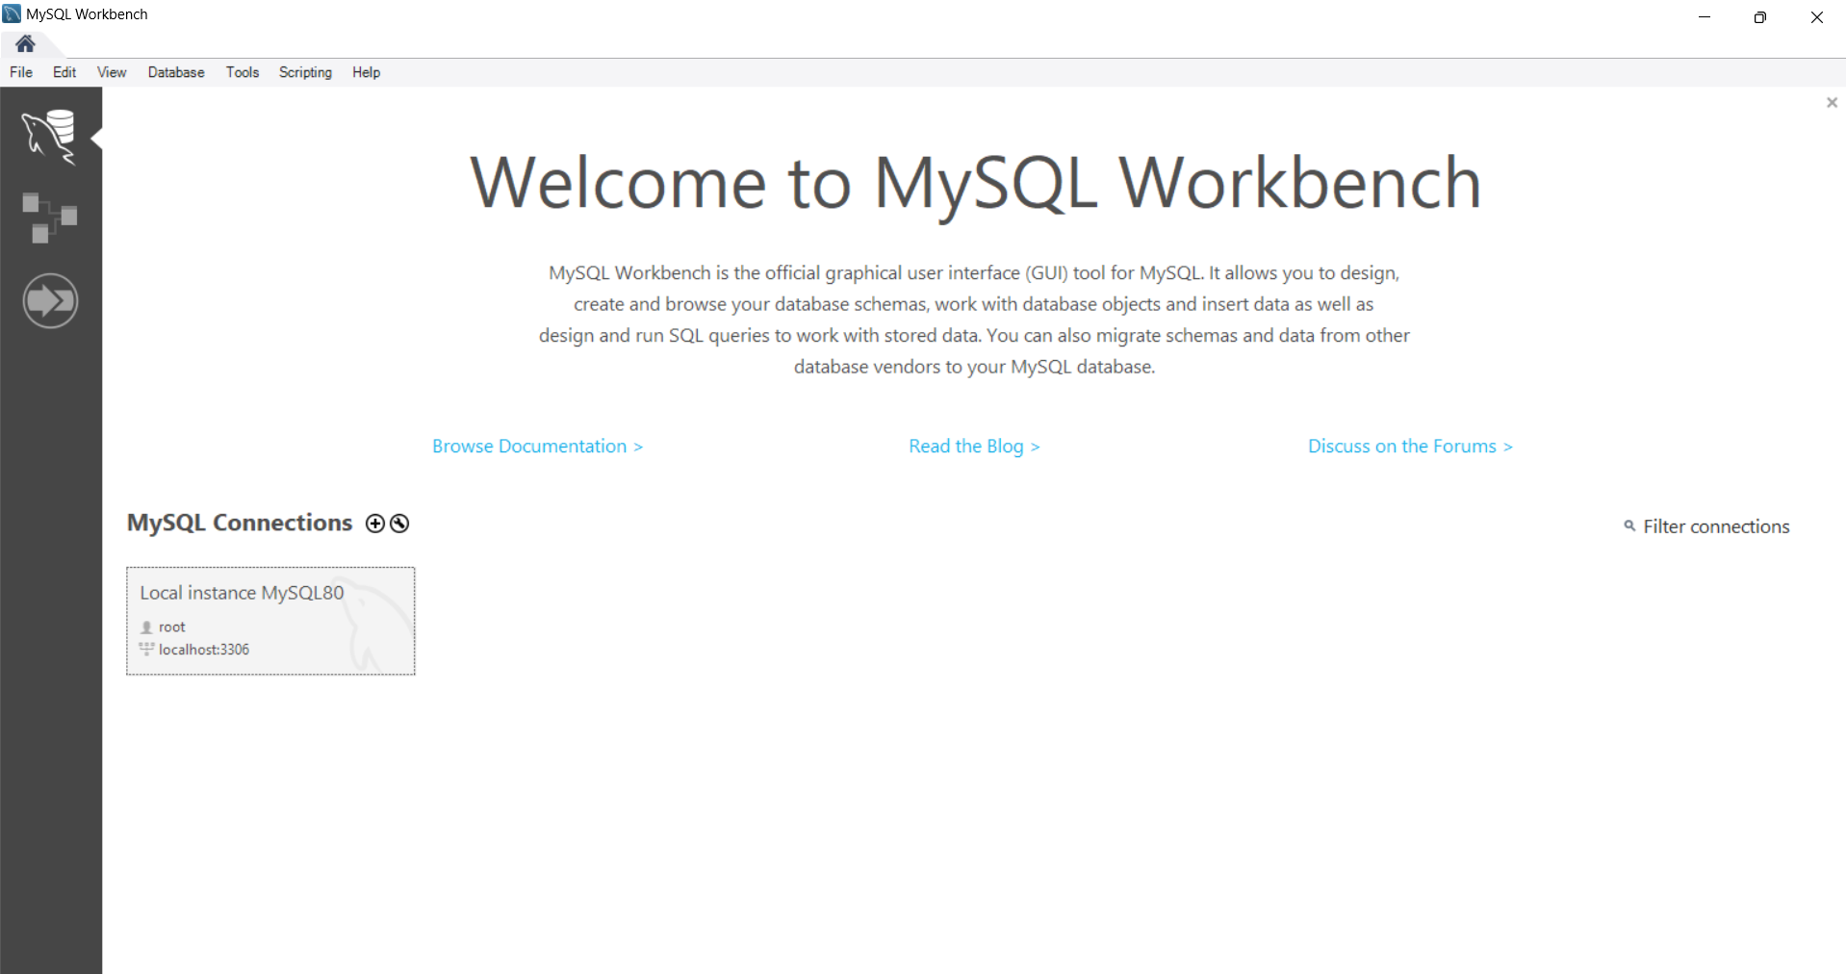
Database Setup
The utilized database management system is MySQL Workbench, optimized and tailored for our needs.

Slide 7
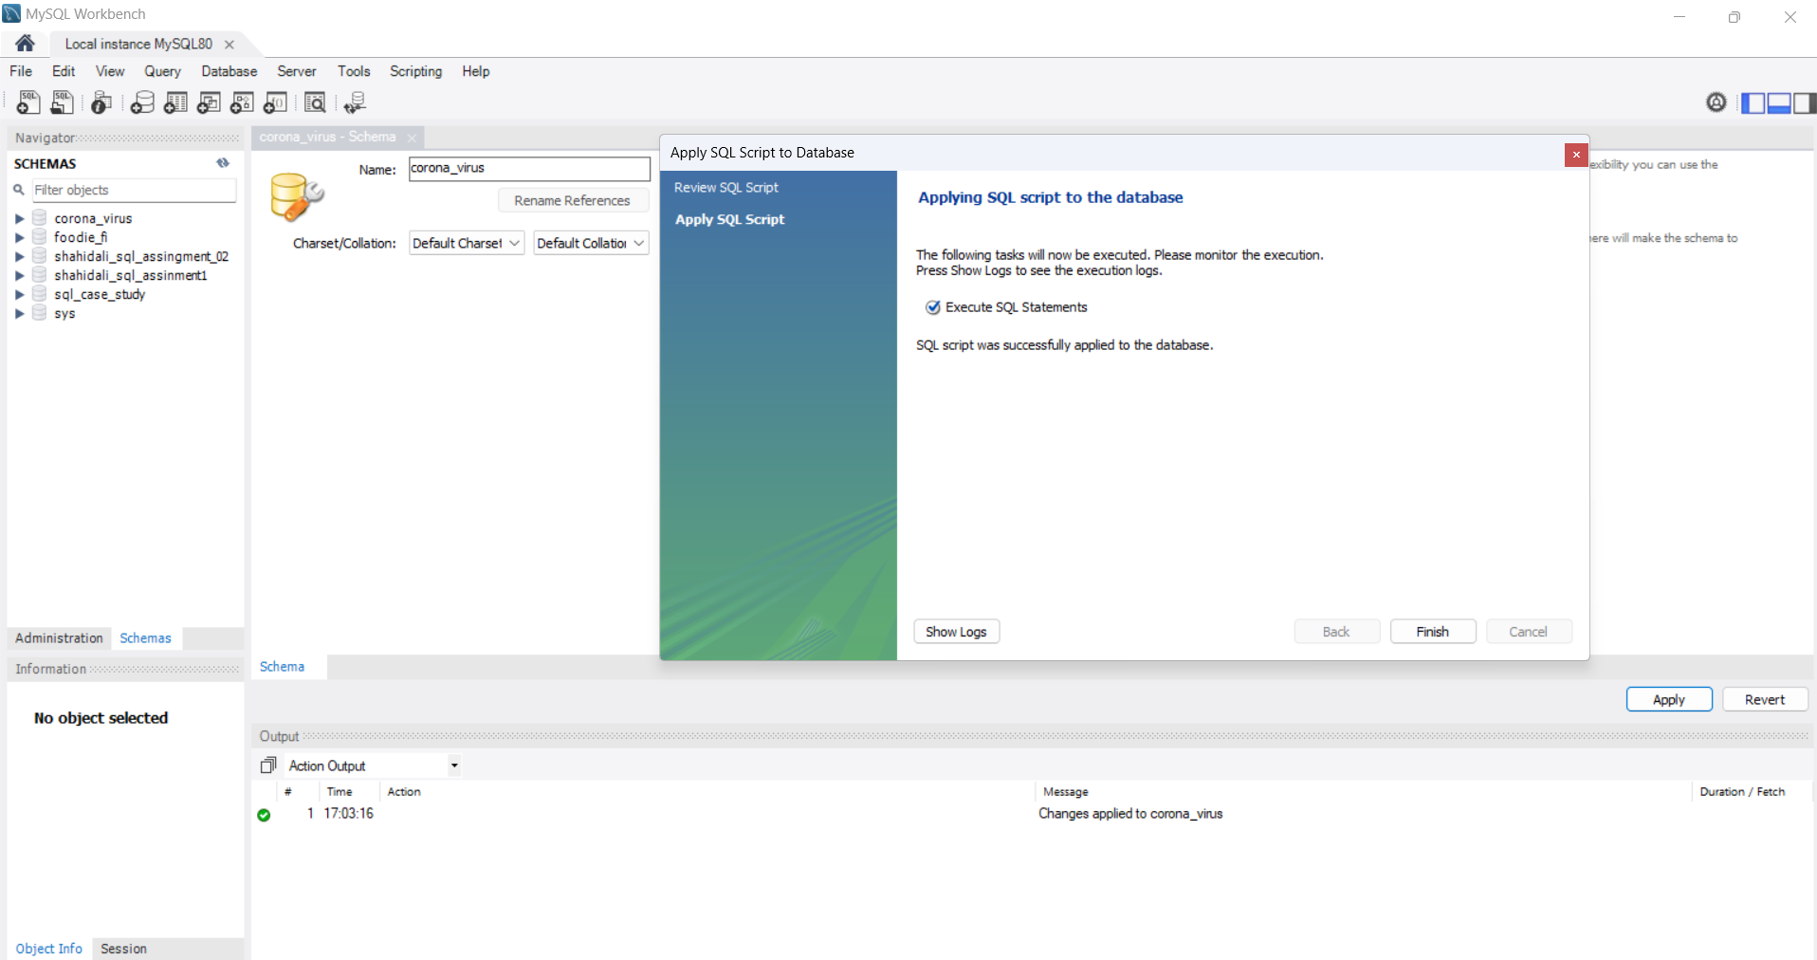
Database Creation
Manually create the new database by selecting the 'Database' option and naming it 'corona_virus'

Slide 8
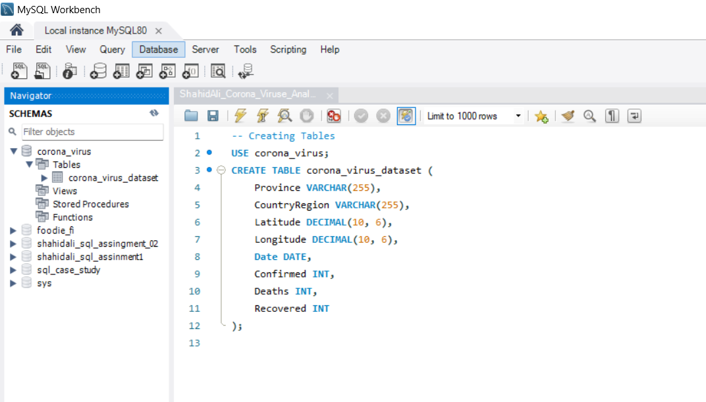
Creating New Table
By executing the following query, we create a new table named 'corona virus dataset' by defining all the columns provided in the dataset

Slide 9
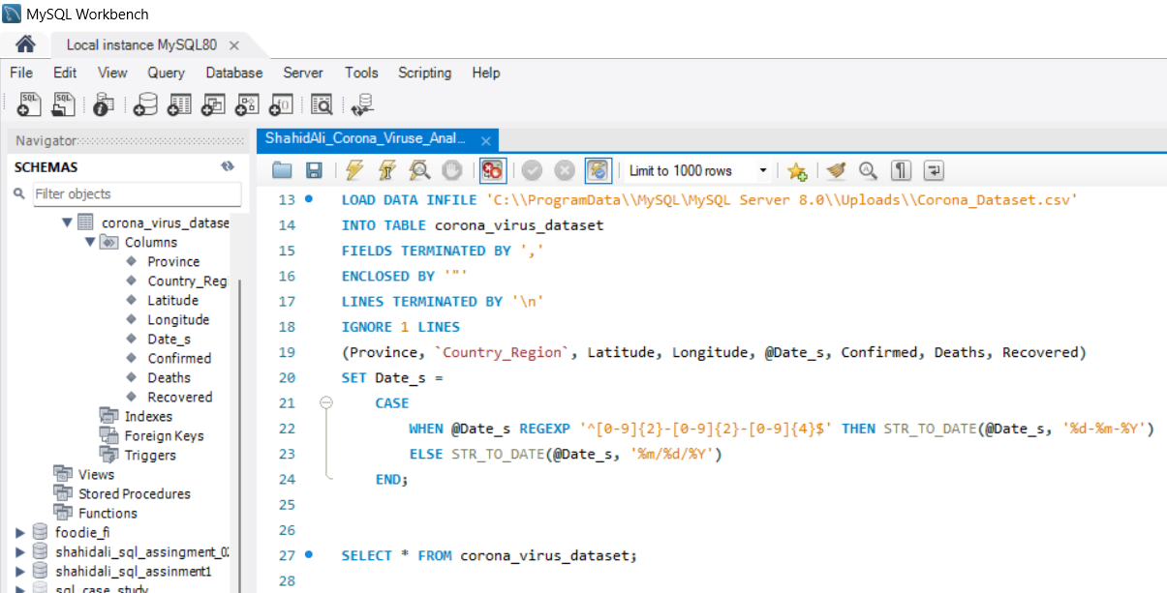
Importing Dataset
By executing the following SQL query, we import data from the CSV file 'Corona_Dataset.csv' into the table 'corona_virus_dataset' in the MySQL database

Slide 10
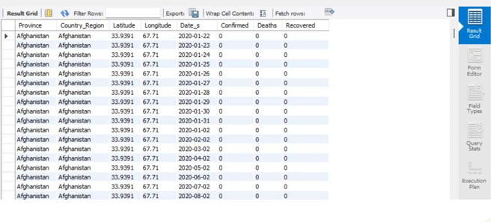
Dataset Uploaded
Now that we have uploaded and properly modified the dataset in MySQL, let's retrieve all records from the 'corona_virus_dataset’ table

Slide 11
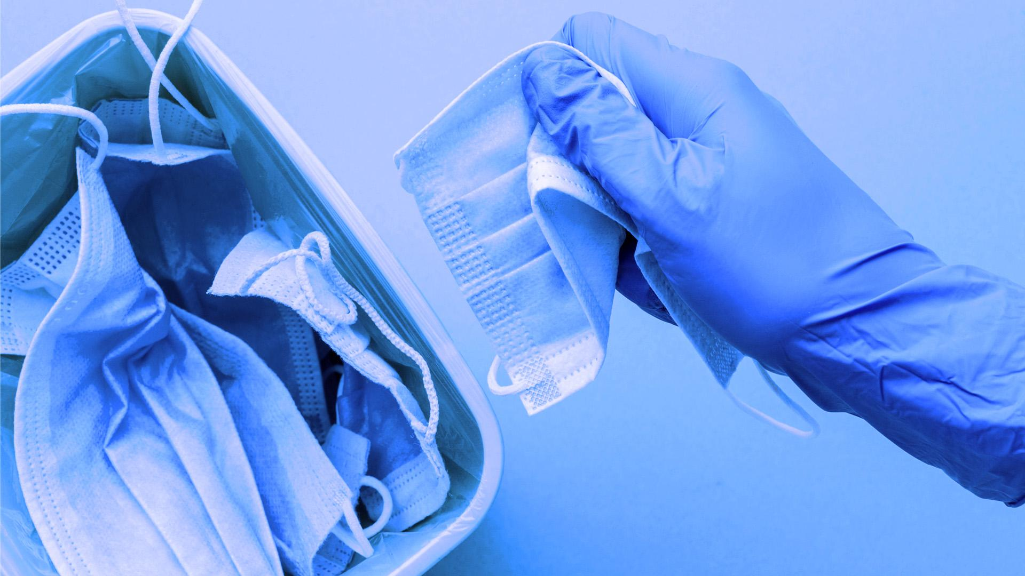
A Picture Is Worth a Thousand Words

Slide 12

Corona Virus Analysis
Now that we have uploaded and properly modified the dataset in MySQL, let's start our analysis. We'll begin by retrieving all records from the 'corona_virus_dataset’.

Slide 13
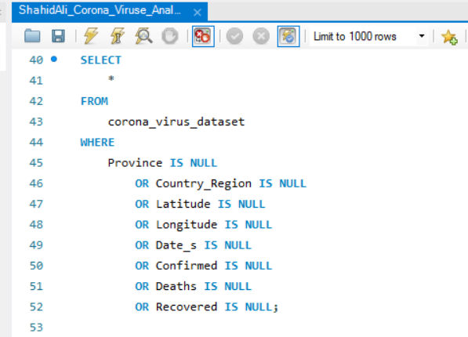
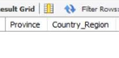
Question 1
Write a code to check NULL values?
Answer: After executing this SQL code, we found that there are no NULL values in any of the columns in 'corona_virus_dataset' table.

Slide 14
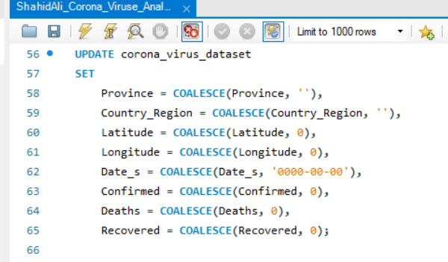

Question 2
If NULL values are present, update them with zeros for all columns?
Answer: There is no NULL values were found in any of the columns within the 'corona_virus_dataset' table, so there was not any records updated with zeros.

Slide 15
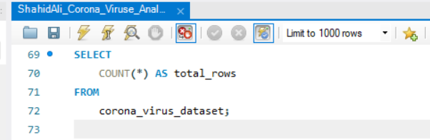
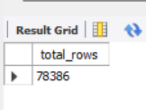
Question 3
Check total number of rows?
Answer: After executing this SQL code, we found that the dataset consists of 78,386 records.

Slide 16
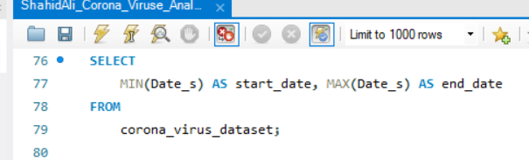
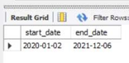
Question 4
Check what is start_date and end_date?
Answer: After executing the above SQL code, we found that there are no NULL values in any of the columns in 'corona_virus_dataset' table.

Slide 17
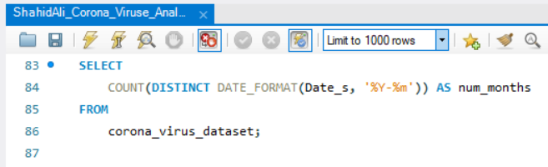
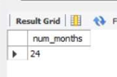
Question 5
Total Number of month present in dataset?
Answer: The start date of the COVID-19 dataset is recorded as January 02, 2020, with the end date as June 12, 2021..

Slide 18
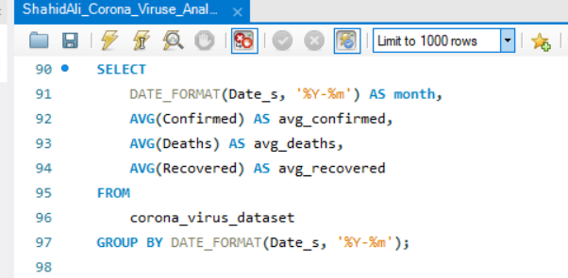
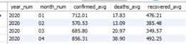
Question 6
Find monthly average for deaths, confirmed, recovered?
Answer: This query extracts the year and month from the Date column, calculates the average number of confirmed cases, deaths, and recoveries for each month, and rounds the averages to two decimal places.

Slide 19
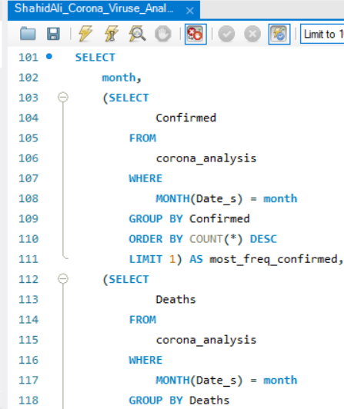
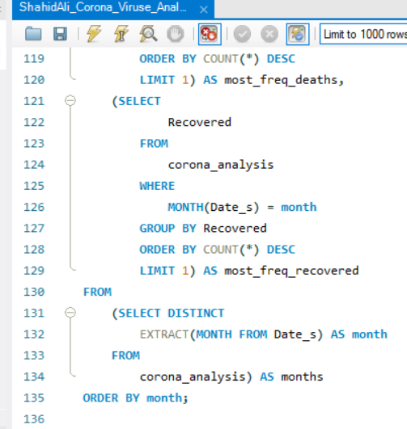
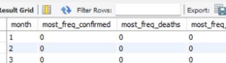
Question 7
Find most frequent value for deaths, confirmed, recovered each month?
Answer: The query extracts unique months, labels them, finds the most frequent values for confirmed cases, deaths, and recoveries, and sorts by month.

Slide 20
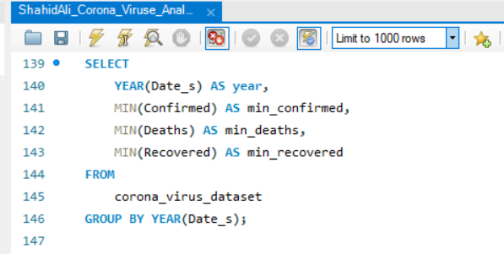
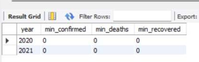
Question 8
Find minimum values for confirmed, deaths, recovered per year?
Answer: The minimum value of confirmed cases, deaths, and recoveries per year is zero.

Slide 21
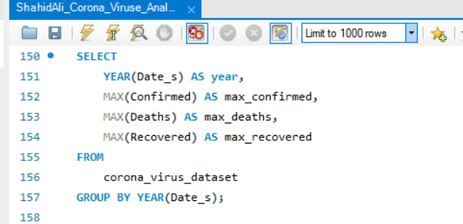
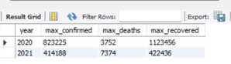
Question 9
Find maximum values of deaths, confirmed, recovered per year?
Answer: The year 2020 saw the highest count of confirmed cases, totaling 823,225. Conversely, 2021 documented the highest number of deaths at 7,374. However, 2020 also recorded the most recoveries, reaching 1,123,456.

Slide 22
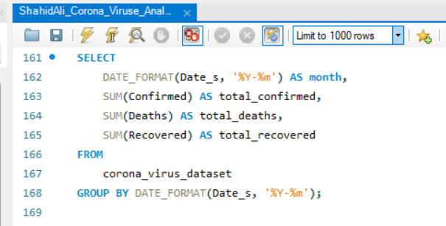
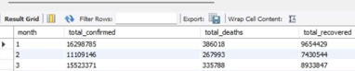
Question 10
The total number of case of deaths, confirmed, recovered each month?
Answer: This query shows the total number of confirmed, deaths, and recovered cases each month.

Slide 23
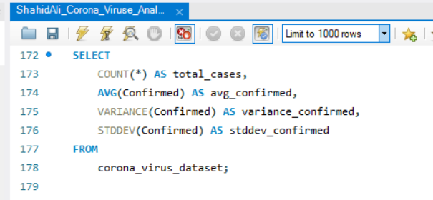
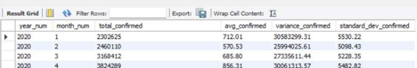
Question 11
Check how corona virus spread out with respect to confirmed case?
(E.g.: total confirmed cases, their average, variance & STDEV )
Answer: By running this query, we find the total confirmed cases, their average, variance, and standard deviation.

Slide 24
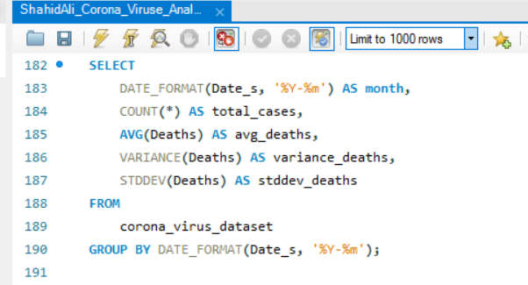
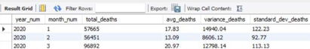
Question 12
Check how corona virus spread out with respect to death case per month?
(E.g.: total confirmed cases, their average, variance & STDEV )
Answer: By running this query, we find the death cases per month, their average, variance, and standard deviation.

Slide 25
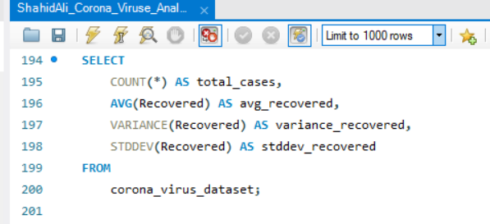
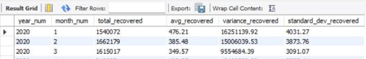
Question 13
Check how corona virus spread out with respect to recovered case?
(E.g.: total confirmed cases, their average, variance & STDEV )
Answer: By running this query, we find the total spread of coronavirus with respect to recovered cases, their average, variance, and standard deviation.

Slide 26
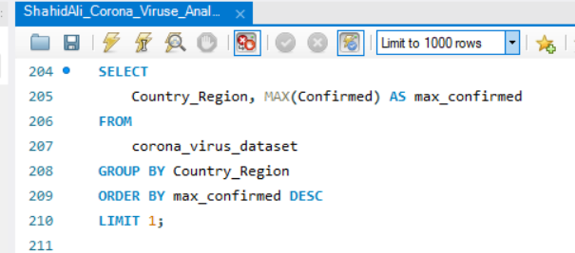
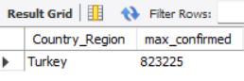
Question 14
Find country having highest number of the Confirmed case?
Answer: The country with the highest number of confirmed cases is Turkey, with 823,225 cases.

Slide 27
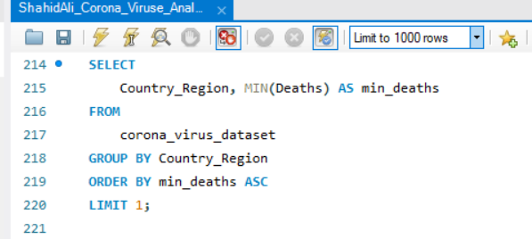
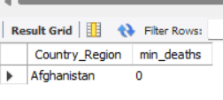
Question 15
Find country having lowest number of the death case?
Answer: The country with the lowest number of death cases is Afghanistan, with 0 deaths.

Slide 28
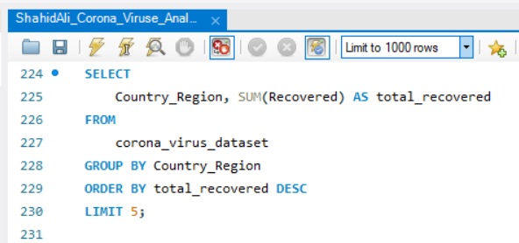
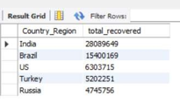
Question 16
Find top 5 countries having highest recovered case?
Answer: The top 5 countries and their highest recovery counts are:
India (28,089,649)
Brazil (15,400,169)
US (6,303,715)
Turkey (5,202,251)
Russia (4,745,756)

Slide 29
Thanks!
Do you have any question?
itsali0320@gmail.com
+92 312 78302 288

Slide 30
Alternative Resources
Vectors
Illustrated coronavirus waste in the ocean
Photos
Used medical masks and gloves top view
Top view disposable medical masks and hand with gloves

Slide 31
Alternative Resources
Vectors
Illustrated coronavirus waste in the ocean
Photos
Used medical masks and gloves top view
Top view disposable medical masks and hand with gloves

Slide 32
Resources
Vectors
Coronavirus waste in the ocean wallpaper illustrated
Sad background of coronavirus waste
Coronavirus waste - background
Coronavirus waste background
Sad background of coronavirus waste in the ocean
Photos
Person wearing protection gloves taking a disposable mask
Hazardous waste to nature medical masks
Top view disposable medical masks
Icon Pack
Personal protective equipment PPE

Slide 33
Instructions for use (free users)
In order to use this template, you must credit Slidesgo by keeping the Thanks slide.
You are allowed to:
Modify this template.
Use it for both personal and commercial purposes.
You are not allowed to:
Sublicense, sell or rent any of Slidesgo Content (or a modified version of Slidesgo Content).
Distribute this Slidesgo Template (or a modified version of this Slidesgo Template) or include it in a database or in any other product or service that offers downloadable images, icons or presentations that may be subject to distribution or resale.
Use any of the elements that are part of this Slidesgo Template in an isolated and separated way from this Template.
Delete the “Thanks” or “Credits” slide.
Register any of the elements that are part of this template as a trademark or logo, or register it as a work in an intellectual property registry or similar.
For more information about editing slides, please read our FAQs or visit Slidesgo School:
https://slidesgo.com/faqs and https://slidesgo.com/slidesgo-school

Slide 34
Instructions for use (premium users)
In order to use this template, you must be a Premium user on Slidesgo.
You are allowed to:
Modify this template.
Use it for both personal and commercial purposes.
Hide or delete the “Thanks” slide and the mention to Slidesgo in the credits.
Share this template in an editable format with people who are not part of your team.
You are not allowed to:
Sublicense, sell or rent this Slidesgo Template (or a modified version of this Slidesgo Template).
Distribute this Slidesgo Template (or a modified version of this Slidesgo Template) or include it in a database or in any other product or service that offers downloadable images, icons or presentations that may be subject to distribution or resale.
Use any of the elements that are part of this Slidesgo Template in an isolated and separated way from this Template.
Register any of the elements that are part of this template as a trademark or logo, or register it as a work in an intellectual property registry or similar.
For more information about editing slides, please read our FAQs or visit Slidesgo School:
https://slidesgo.com/faqs and https://slidesgo.com/slidesgo-school

Slide 35
Fonts & colors used
This presentation has been made using the following fonts:
Asap
(https://fonts.google.com/specimen/Asap)
Signika
(https://fonts.google.com/specimen/Signika)
#1b5d93
#ffffffff
#78b3f9
#5194d6
#0e3759
#b4d5fc

Slide 36





Storyset
Create your Story with our illustrated concepts. Choose the style you like the most, edit its colors, pick the background and layers you want to show and bring them to life with the animator panel! It will boost your presentation. Check out How it Works.
Pana
Amico
Bro
Rafiki
Cuate

Slide 37
Use our editable graphic resources...
You can easily resize these resources without losing quality. To change the color, just ungroup the resource and click on the object you want to change. Then, click on the paint bucket and select the color you want. Group the resource again when you’re done. You can also look for more infographics on Slidesgo.

Slide 40
JANUARY
FEBRUARY
MARCH
APRIL
MAY
JUNE
PHASE 1
Task 1
Task 2
PHASE 2
Task 1
Task 2
JANUARY
FEBRUARY
MARCH
APRIL
PHASE 1
Task 1
Task 2

Slide 43
...and our sets of editable icons
You can resize these icons without losing quality.
You can change the stroke and fill color; just select the icon and click on the paint bucket/pen.
In Google Slides, you can also use Flaticon’s extension, allowing you to customize and add even more icons.

Slide 44
Educational Icons
Medical Icons

Slide 45
Business Icons
Teamwork Icons

Slide 46
Help & Support Icons
Avatar Icons

Slide 47
Creative Process Icons
Performing Arts Icons

Slide 48
Nature Icons

Slide 49
SEO & Marketing Icons

Slide 50


